Slide 1
Optimal Location for Hospital in Delhi
By Prafull Varshney

Slide 2

Introduction
Objective
Target People
Find a optimal location for hospital in Delhi
People interested in opening hospital in Delhi

Slide 3

Introduction
factors that will influence our decision are
Number of existing hospitals in the neighborhood.
Distance of neighborhood from city center.

Slide 4
Data Sources
Number of hospitals and their location in every neighborhood will be obtained using Foursquare API.
Latitude and longitude of an area will be obtained using geocoder python package.

Slide 5
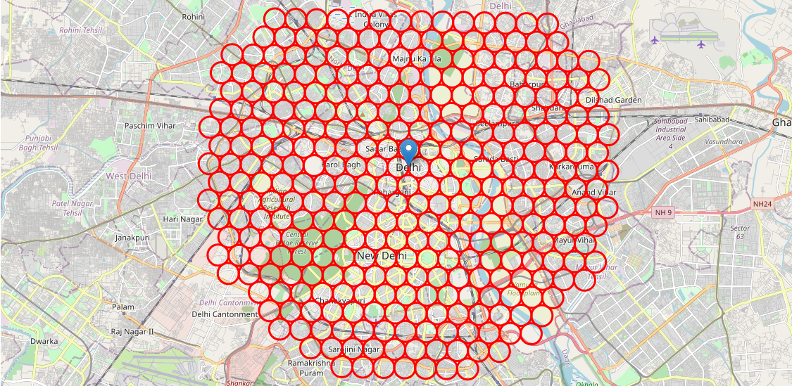
Data Cleaning
Divide the area of ~10 km around Central Delhi into circle of radius 500 m (Neighborhoods)

Slide 6
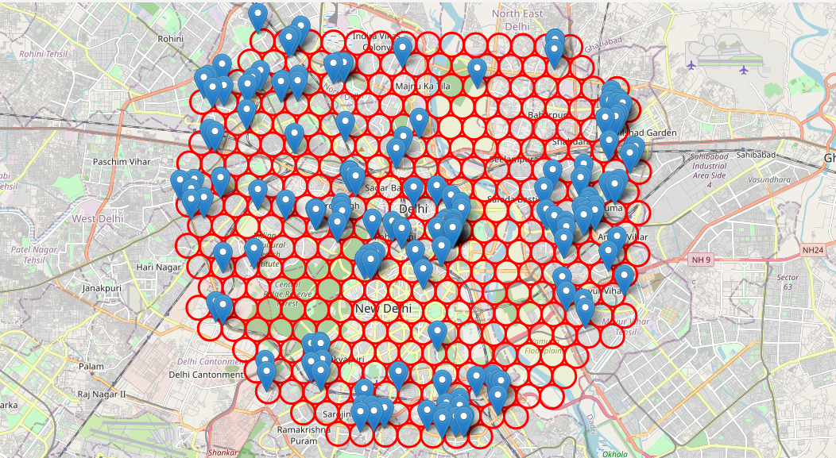
Data Cleaning
Find hospitals in each neighborhood using foursquare

Slide 7
Methodology
collect the required data: location of every hospital within 10km from Central Delhi

Slide 8
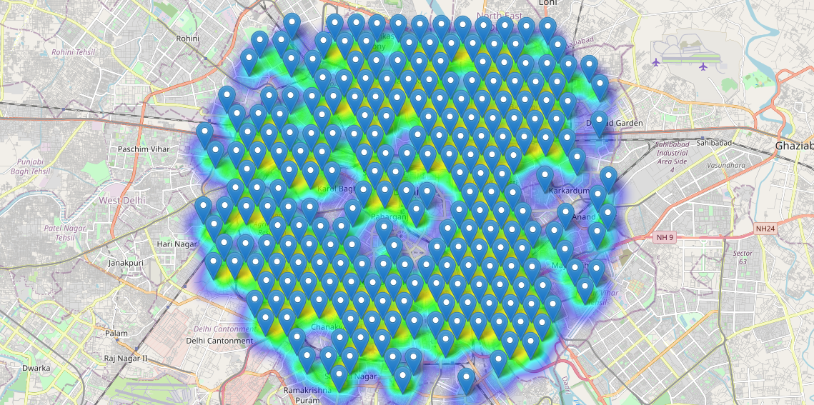
Methodology
use heat maps to identify a few promising areas close to center with low number of hospital in general

Slide 9
Methodology
present map of all such locations but also create clusters (using k-means clustering) of those locations to identify general zones / neighborhoods / addresses which should be a starting point for final 'street level' exploration and search for optimal venue location by stakeholders.

Slide 10
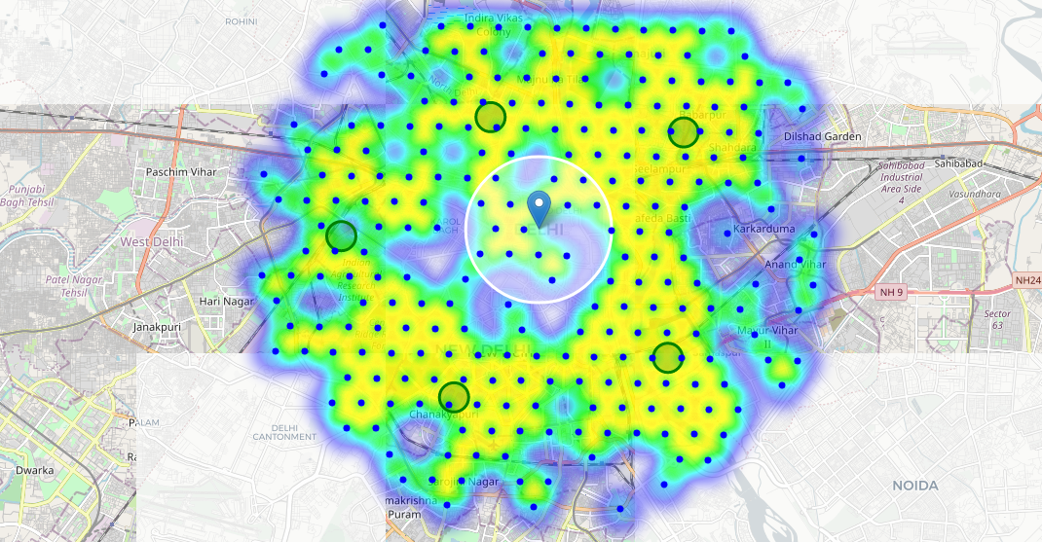
Methodology
Create clusters (using k-means clustering) : 5 Clusters

Slide 11
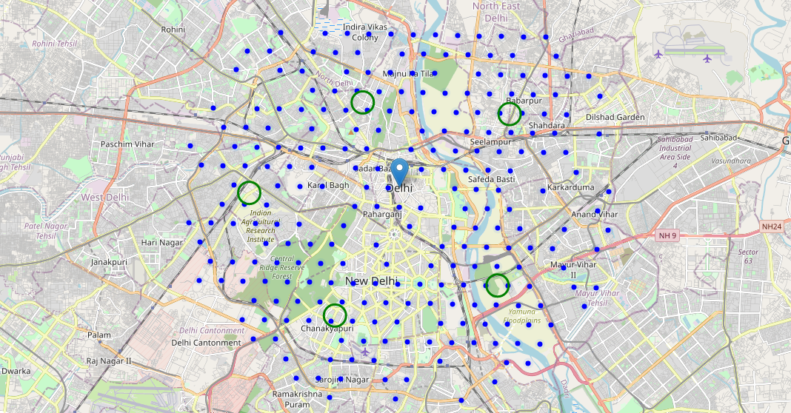
Result
5 clusters (optimal locations) which satisfy our criteria

Slide 12
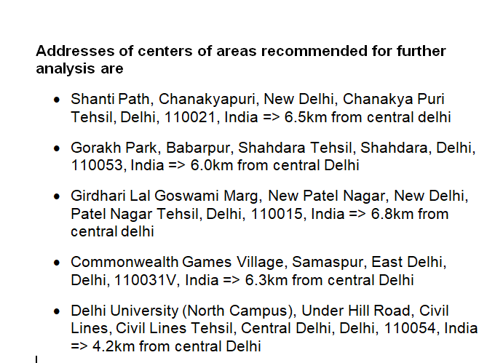
Conclusion

Slide 13


